Slide 1
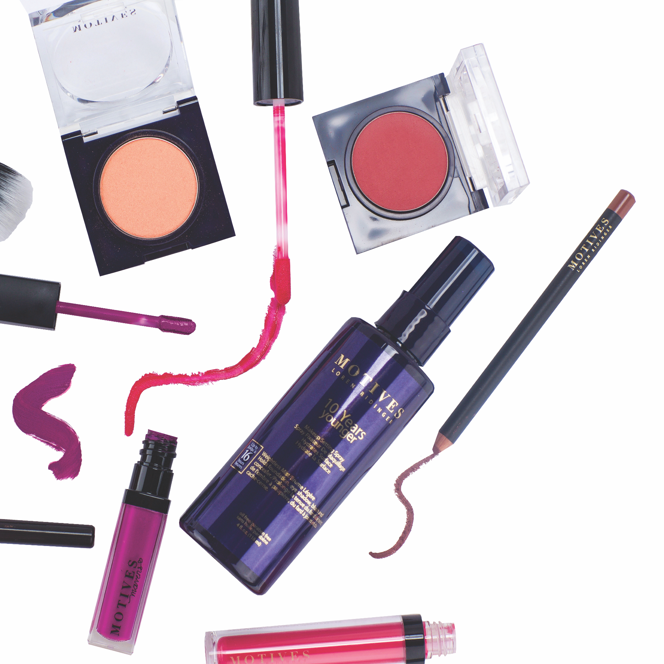


Slide 2
WELCOME TO OUR
PROFESSIONAL OVERVIEW

Slide 3
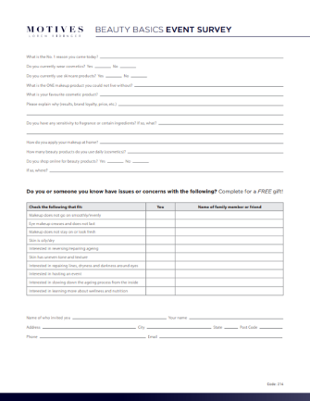
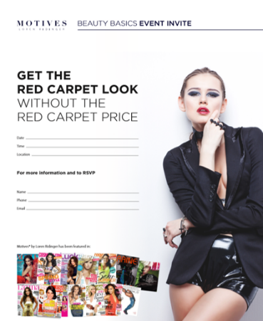

WELCOME TO OUR MOTIVES PROFESSIONAL OVERVIEW
THANK YOU FOR JOINING US!
OUR GOAL IS TO OFFER A FUN & PROFESSIONAL ENVIRONMENT WHERE YOU CAN NETWORK, TRY SOME PRODUCT, AND LEAVE FEELING MORE HOPEFUL & BEAUTIFUL THAN BEFORE YOU CAME.
Guests – Complete Survey for free gift
NEXT: Education & Demonstration
Personal Recommendations & Follow-up

Slide 4
“
BEAUTY BEGINS THE MOMENT YOU DECIDE TO BE YOURSELF
”

Slide 5


BEAUTY
INDUSTRY
DEMANDS
ESTIMATED GROWTH OF
OVER 57% OVER 8 YEARS
  THE GLOBAL BEAUTY & PERSONAL
  CARE PRODUCTS MARKET IS ANTICIPATED
  TO GROW FROM $432.7 BILLION IN 2016
  TO $750 BILLION BY 2024
https://www.inkwoodresearch.com/reports/beauty-personal-care-products-market/

Slide 6
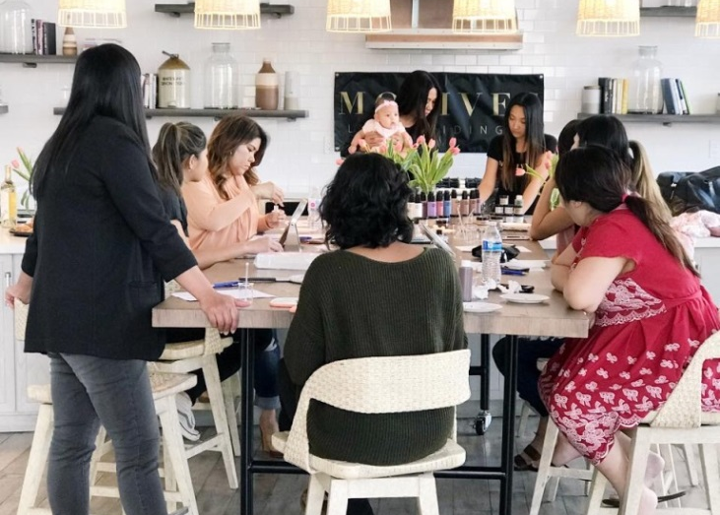
EMOTION IS AT
THE FOREFRONT
90% of the decisions we make are
emotional, and thinking about
what will drive the beauty industry’s
growth and change in the year to
come, emotion is at the forefront.
After all, what can be more
emotional than beauty?
http://customdirectpromo.com/wp-content/uploads/2018/01/The-Beauty-Economy-Outlook-for-2018.pdf

Slide 7
PERFECT POSITIONING –
ENTREPRENEURISM
LEVERAGE
As a Motives Beauty Advisor, you can position yourself in the
middle of this purchasing power to earn a piece of the pie!
THE PROFITS HAVE TO GO SOMEWHERE
We offer the best products in the marketplace, at the most competitive
price, while offering the ability to leverage a proven business system
**Source: http://www.economist.com/node/1795852

Slide 8
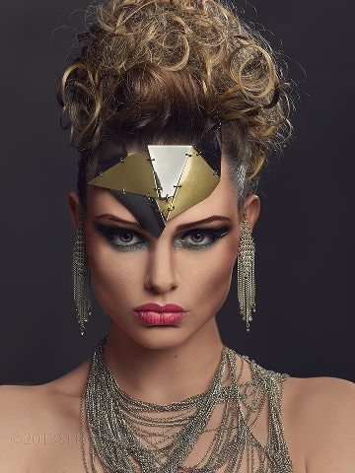
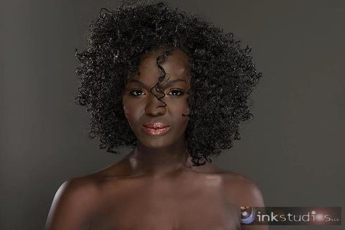
WAKE UP
& MAKE-UP

Slide 9
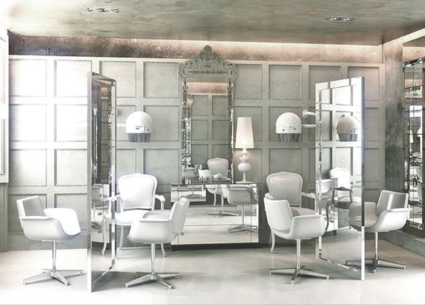
BEAUTY INDUSTRY - EVOLUTION
TRADITIONAL SALON – 43 BILLION DOLLAR INDUSTRY
01.
  CHALLENGES
- 60% of Hair Stylists are freelance
(independent or booth rental)
- Diversion with traditionally ‘exclusive’
professional products
- Your best stylists can become
your competition
- On-going education & marketing
can be expensive

Slide 10
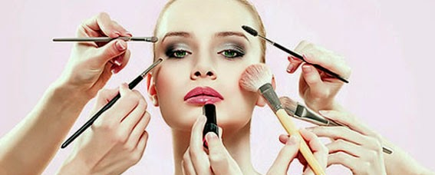
BEAUTY INDUSTRY - EVOLUTION
INDUSTRY DISRUPTORS
01.
05.
  DRY BAR
  MARKETING
- Franchised focused service
- Traditional forms of advertising
no longer effective
02.
  GLAMSQUAD
06.
- ‘Uber of beauty, On-demand
services; 6 am – 9 pm
  BEAUTY INFLUENCERS
03.
  GROUPON
- Community of consumers loyal
to discounted service
04.
  DIVERSION
- No exclusivity or profitability,
big brands go direct to consumer
This Photo by Unknown Author is licensed under CC BY-NC-ND

Slide 11
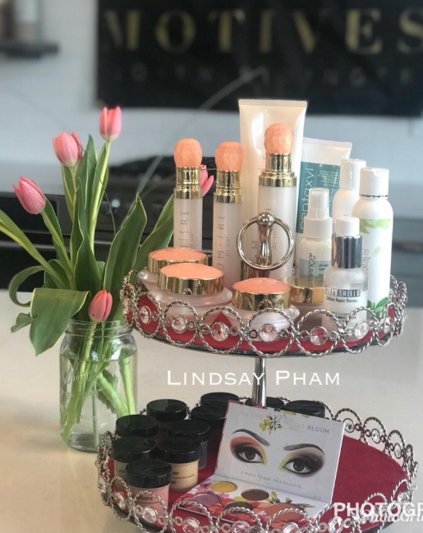
OUR SOLUTION
INDUSTRY DISRUPTORS
01.
  ENTREPRENEURIAL OPPORTUNITY
- In business for yourself, but not by yourself. You
control your schedule and determine your worth.
02.
  CREATIVE CLOUD
- You are encouraged to brand yourself and to market
products and services both online and in person
03.
  QUALITY CONTROL
- Over the people / products you align yourself with
04.
  INTEGRITY
- In the culture provided by our company. We set the
standard to add value to your existing brand and
business, not detract or control the structure.

Slide 12
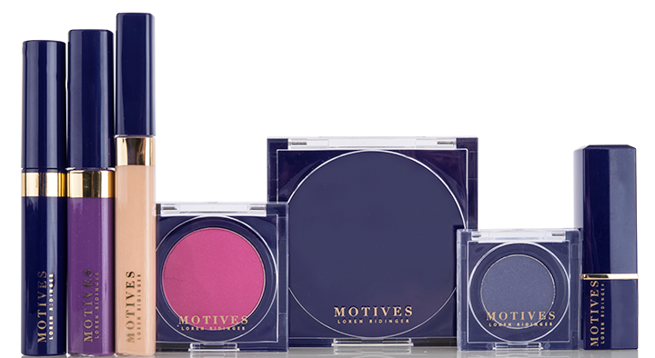
MOTIVES® COSMETICS
OPEN THE DOOR
PEOPLE ARE ALREADY PURCHASING COSMETICS, OUR GOAL
IS TO TRANSFER WHERE AND WHO THEY ARE BUYING FROM
UNIQUE POINTS OF DIFFERENCE:
- High-end prestigious brand at affordable prices
- Customisable cosmetics line
- Complements every age, skin-tone and skin type
- Perfect for all occasions
- Fully pigmented cosmetics for photo shoots
and fashion shows
- Proprietary formulas
- No animal testing / cruelty free line
*Please note that all products displayed in images are available in every market.

Slide 13
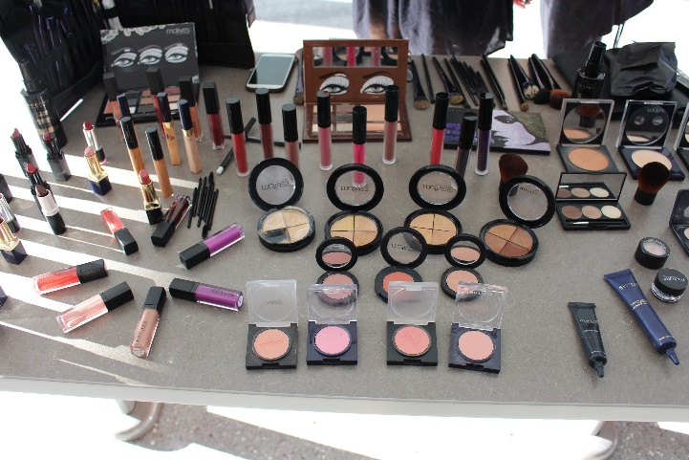
MOTIVES® COSMETICS
OFFERS CLIENTS
- One-on-one consultations from trained beauty
advisors to maximise client investment in products
- Professional products at affordable prices
- Education on Beauty from the Inside Out
- Customised skin care regimens
- Fun Application Workshops to build confidence
- Colour cosmetics with the HIGHEST
quality ingredients.
- Hostess Incentives to pair with educational Retail
Events (Beauty Basics, It’s Your Time to Shine, All
About Skin, etc.)

Slide 14
MISSION STATEMENT
PEOPLE EMPOWERING PEOPLE
“The ability to make people look and feel better while
achieving the lifestyle they have always dreamed about.”
- LOREN RIDINGER

Slide 15
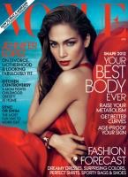
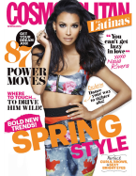
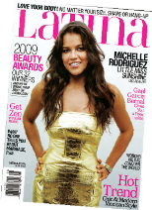

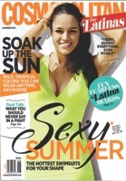
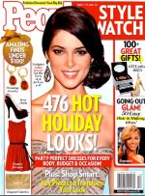




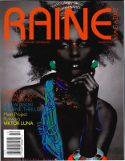
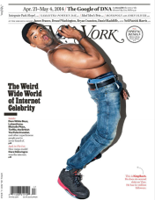


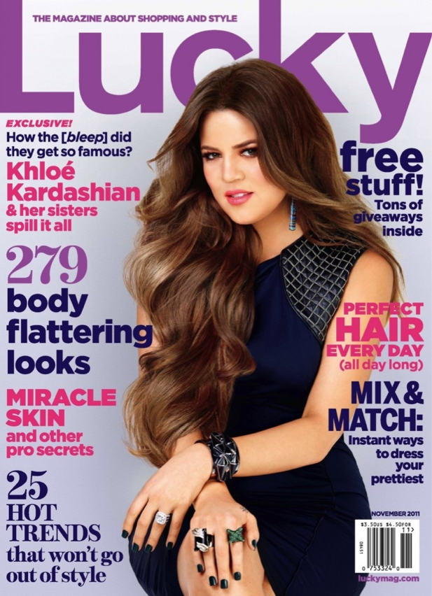
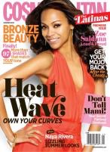
MOTIVES® BY LOREN RIDINGER
HAS BEEN FEATURED IN:
New York Post
In Touch magazine
Every Day with Rachael Ray magazine
Bravo’s “The Fashion Show”
People En Español magazine
Life & Style magazine
Us Weekly magazine
Latina magazine
100 Thousand Club magazine
Elle.com
New York
Vogue
People Style Watch
InStyle
Glamour
Allure
Cosmopolitan
Cosmo for Latinas
Lucky

Slide 16



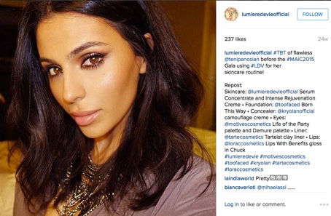

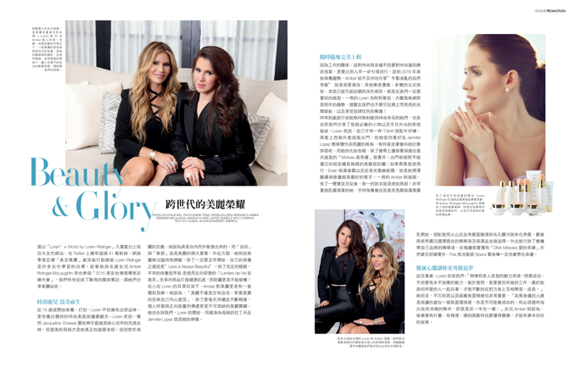
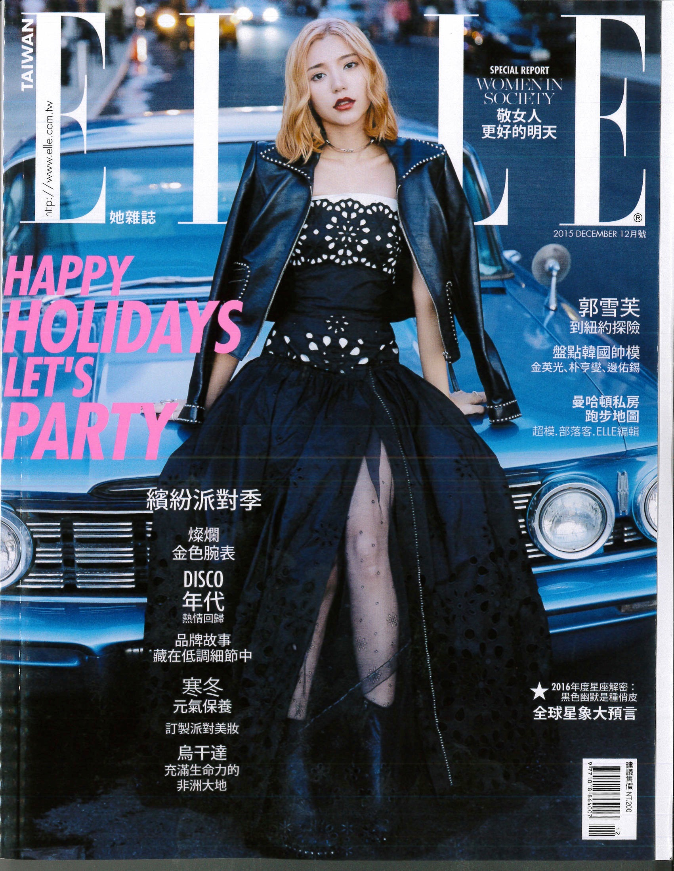
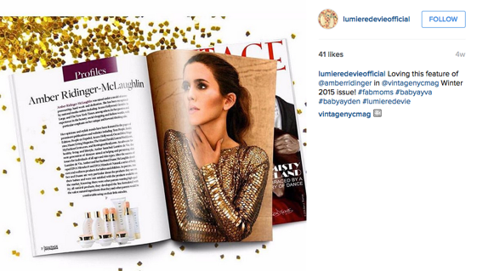




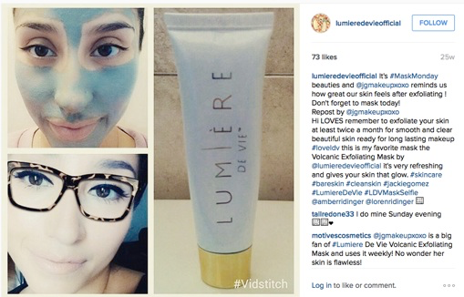

Slide 17

#beautypreneur

Slide 18
“
IMPERFECTION IS BEAUTY, MADNESS IS GENIUS AND IT’S BETTER TO BE ABSOLUTELY RIDICULOUS THAN ABSOLUTELY BORING
”
- MARILYN MONROE
PRODUCT OF THE MONTH FEATURE .. TIME TO PLAY!
Let us offer some education with a live demonstration

Slide 19

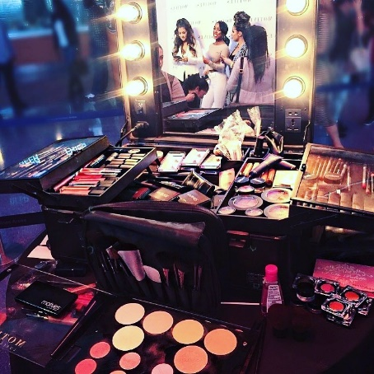
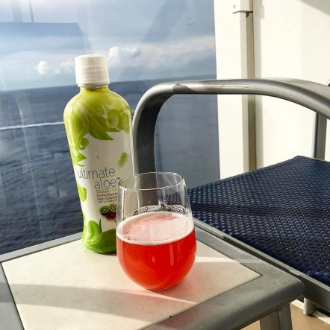
OFFERING CLIENTS …
Personalised Skincare Regimen
Cosmetic Consultations
Beauty from the Inside Out
Client relationships are everything to us and we pride ourselves
on being able to service them with the best of the best products
across complimentary industries

Slide 20
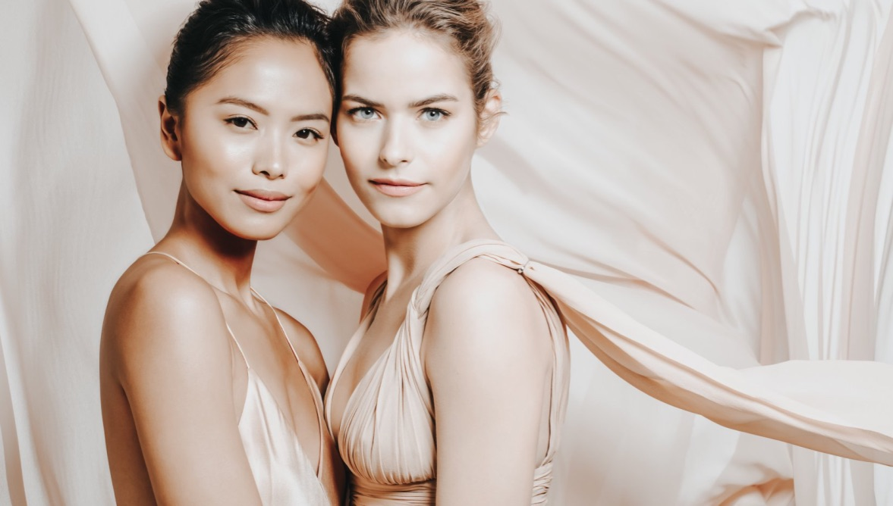
BEAUTY TRENDS
As the global population grows and
The importance of skin care becomes
More well known, the global skin
Care market is projected to increase
FROM 134.5 BILLION DOLLARS
IN 2018 TO OVER 180 BILLION
BY 2024
https://www.statista.com/topics/4517/us-skin-care-market/

Slide 21
BEAUTY TRENDS
SKINCARE SUPPLEMENTS
“Introducing a supplement into our
skincare will become commonplace.”
https://www.harpersbazaar.com/uk/beauty/beauty-shows-trends/a14415615/beauty-trends-2018/

Slide 22
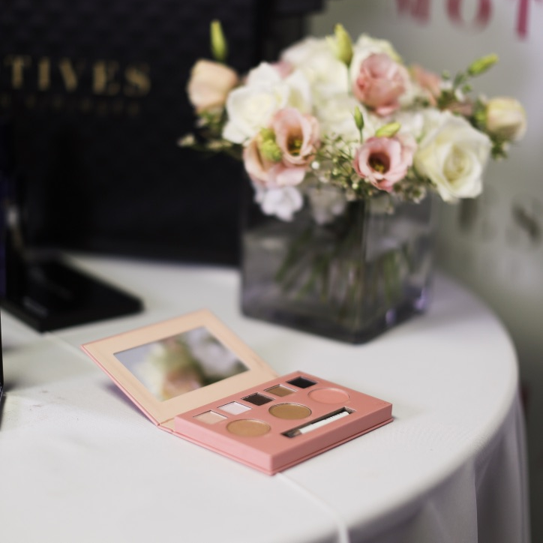
UNIQUE EXPERIENCE
- As a brokerage company, we only offer the
best of the best products!
- By going directly from the manufacturer to the
consumer, we are able to keep costs down and pass
along the savings through affordable prices
As Beauty Advisors, priding ourselves on 1 to 1
marketing, our main goal is to customise the
product selection uniquely to you!
Since our business is built on word of mouth, we
have a program designed to incentivise (and
thank you) for sharing your experience!

Slide 23
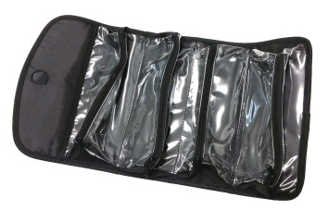
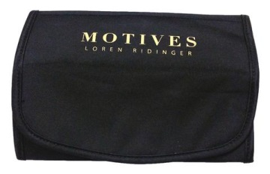
ENCOURAGE THEM TO
HOST A HOME EVENT
AVAILABLE:
UnFanchise.com>Help & Training>
Support Materials>University Majors & Specialties> Cosmetics - Motives
Hostess Information Guide
UTILISE THE HOSTESS INCENTIVE PROGRAM
  5 OBJECTIVES / TASKS FOR THE HOSTESS TO COMPLETE
  TO EARN AUD$100 IN PRODUCT OF THEIR CHOICE
01.
AUD$20 Host Event on the original date
02.
AUD$20 to have a minimum of 5 attendees (over the age of 18)
03.
AUD$20 with a minimum of AUD$200 in sales
04.
AUD$20 when 2 of the attendees book their own events
05.
AUD$20 to evaluate the Business Plan
AVAILABLE ON
MARKETAUSTRALIAGEAR.COM

Slide 24
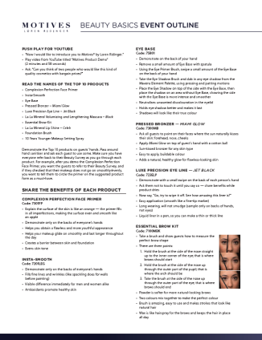
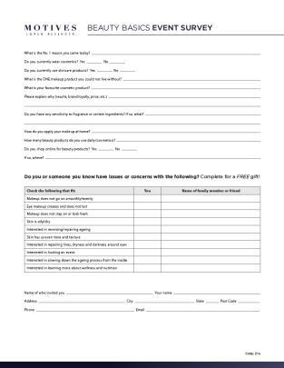
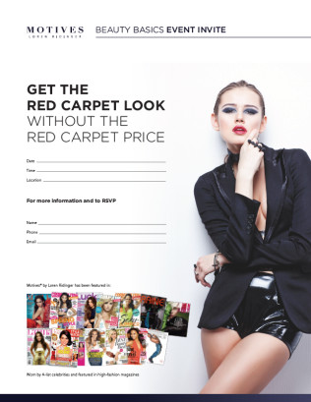
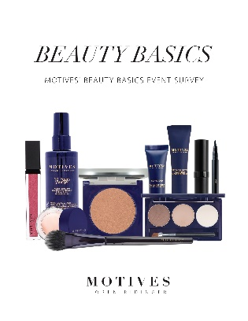
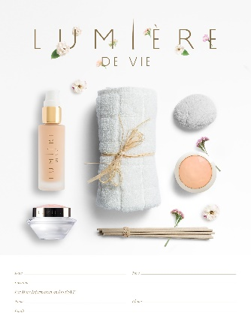

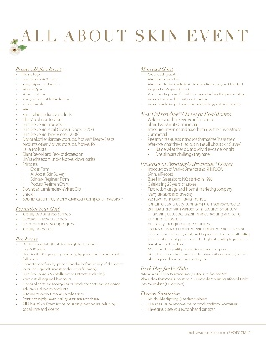
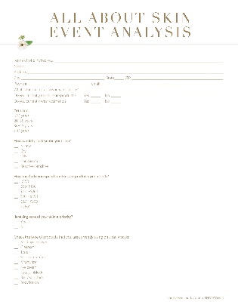
1
BEAUTY
BASICS
2
ALL ABOUT
SKIN

Slide 25

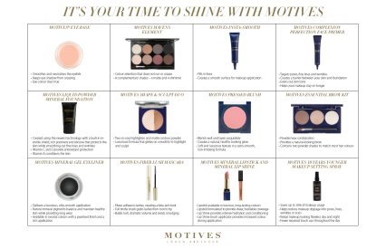
3
IT’S YOUR TIME
TO SHINE

Slide 26
AS AN ENTREPRENEUR,
YOUR EXISTANCE REVOLVES
AROUND THE PEOPLE YOU
INTEND TO SERVE.
“
”
THE HUFFINGTON POST

Slide 27
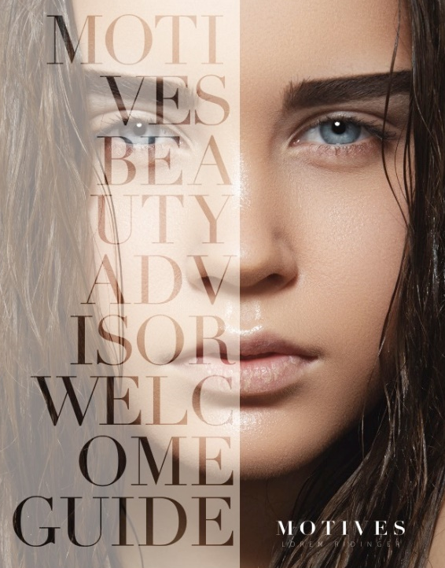
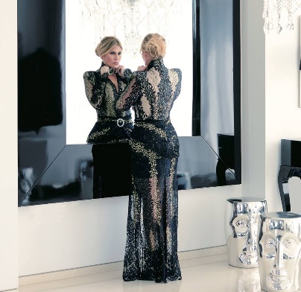
PARTNERSHIP
OPTIONS
WELCOME GUIDE
MOTIVES PROFESSIONAL / BEAUTY ADVISOR (UFO)

Slide 28
WHETHER IT’S OFFERING INDIVIDUAL CONSULTATIONS THAT EXCITES YOU; HOSTING EDUCATIONAL APPLICATION WORKSHOPS, OR TAKING A B2B APPROACH AND IMPLEMENTING WITH PROFESSIONAL ACCOUNTS LIKE SPAS & SALONS, YOU CAN DO IT ALL WITHIN ONE COMPANY!
AND
HAVE THE UTMOST CONFIDENCE THAT YOU ARE ALWAYS OFFERING THE BEST OF THE BEST PRODUCTS PAIRED WITH CUTTING EDGE TECHNOLOGY AND A COMMUNITY OF OTHERS WHO ARE CHEERING FOR YOUR SUCCESS.

Slide 29

BEAUTY ADVISOR CULTURE CODE
Providing our clients the best products in
the marketplace, at an affordable price
Ability to host workshops / clinics that offer
free education
- Focused on beauty from the inside out
- Ability to customise skincare regimens
- FUN! Adding value to those who’s paths we cross.

Slide 30

TRAINING/
EDUCATION
POWERFUL COMBINATION
OF TRAININGS & INTERACTIVE
WORKSHOPS, PAIRED WITH
BUSINESS BUILDING
STRATEGIES
Open to guests as part of
the evaluation process!

Slide 31
EDUCATION AVAILABLE
MOTIVES IN MOTION CURRICULUM:
AUD$40 TRAININGS
Motives: 1 to 1
Skincare: 1 to 1

Slide 32
EDUCATION AVAILABLE
MOTIVES IN MOTION CURRICULUM:
AUD$20 WORKSHOPS
Motives Marketing
Advanced Skincare Solutions
The Art of Makeup – Guided Application

Slide 33
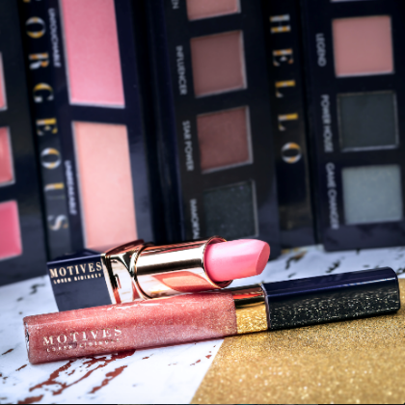
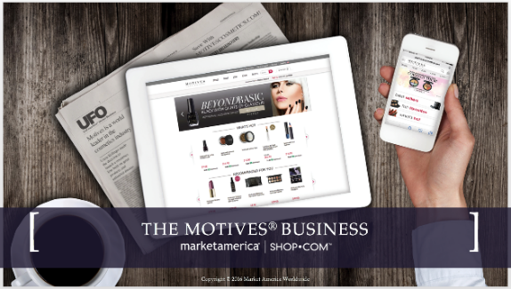
NEXT STEPS …
OUR BRAND IS BUILT, SOLELY, ON WORD OF MOUTH AND WE PRIDE OURSELVES ON CUSTOMISING THE JOURNEY FOR EACH INDIVIDUAL.
LET US KNOW HOW WE CAN SERVICE YOU MOVING FORWARD.
WE THANK YOU FOR YOUR TIME & SUPPORT!
Try Some Product
Host an Event
Evaluate our Marketing Plan

